Slide 1
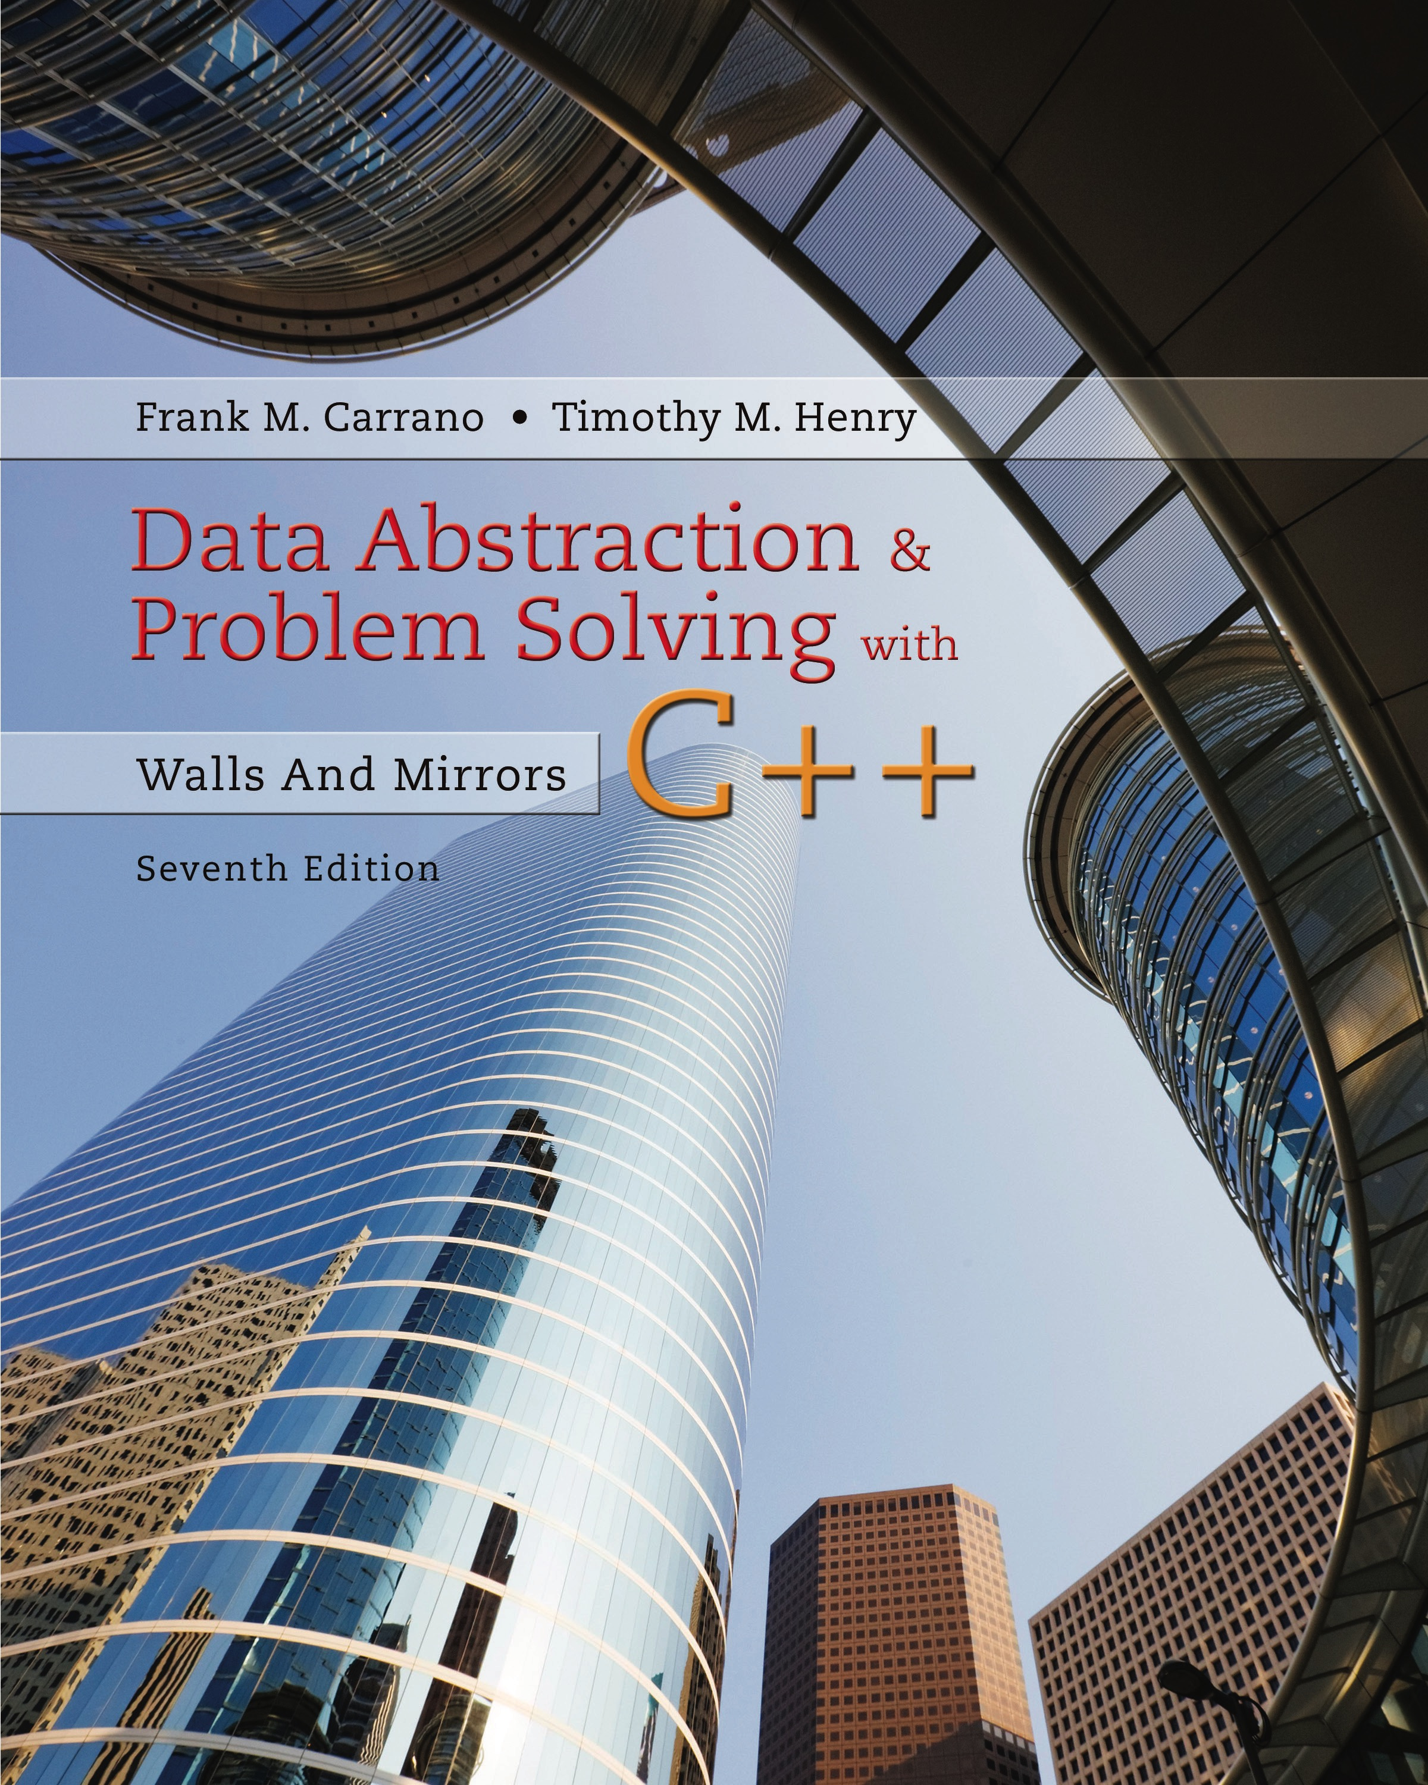
Data Abstraction & Problem Solving with C + +: Walls and Mirrors
Seventh Edition
Chapter 9
List Implementations
Copyright © 2017, 2013, 2007 Pearson Education, Inc. All Rights Reserved
Notes:
If this PowerPoint presentation contains mathematical equations, you may need to check that your computer has the following installed:
1) MathType Plugin
2) Math Player (free versions available)
3) NVDA Reader (free versions available)

Slide 2
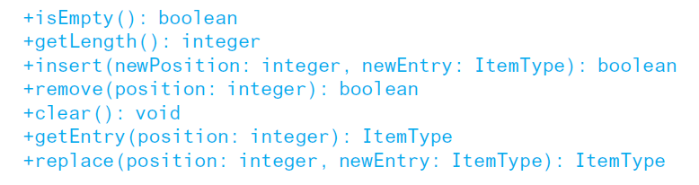
Array-Based Implementation of the A D T List (1 of 2)
List operations in their U M L form

Slide 3
Array-Based Implementation of the A D T List (2 of 2)
Array-based implementation is a natural choice
Both an array and a list identify their items by number
However
A D T list has operations such as getLength that an array does not
Must keep track of number of entries

Slide 4
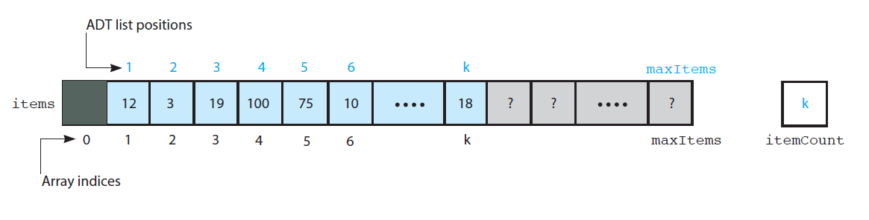
The Header File (1 of 7)
Figure 9-1 An array-based implementation of the A D T list

Slide 5
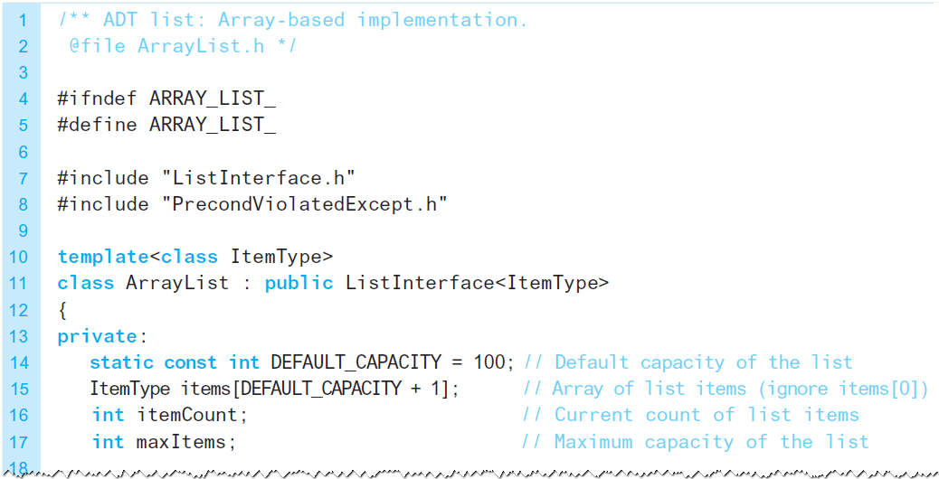
The Header File (2 of 7)
Listing 9-1 The header file for the class ArrayList

Slide 6
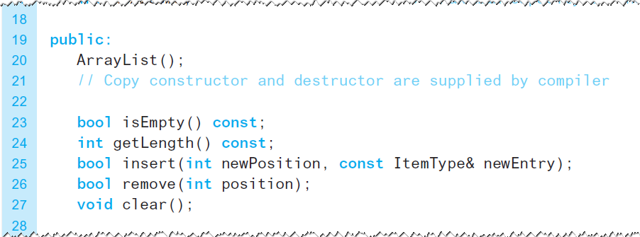
The Header File (3 of 7)
Listing 9-1 [Continued]

Slide 7
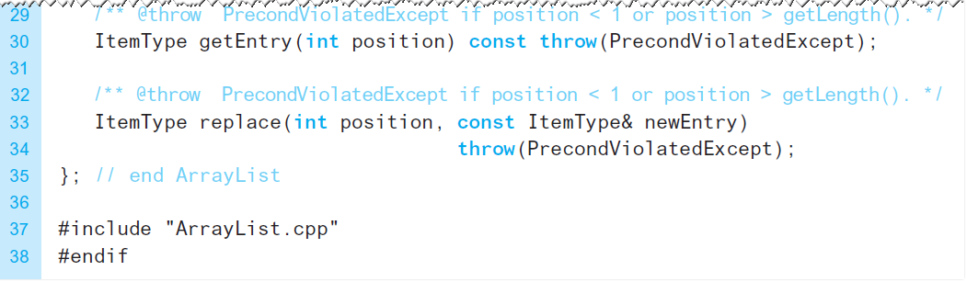
The Header File (4 of 7)
Listing 9-1 [Continued]

Slide 8
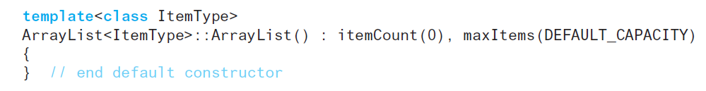
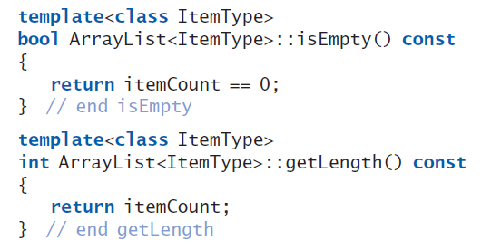
The Implementation File (1 of 24)
Constructor, methods isEmpty and getLength

Slide 9
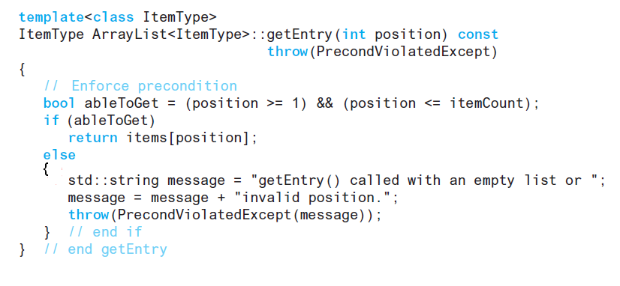
The Implementation File (2 of 24)
Method getEntry

Slide 10
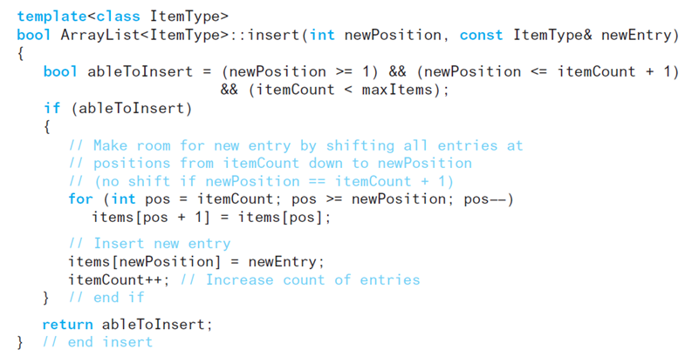
The Implementation File (3 of 24)
Method insert

Slide 11
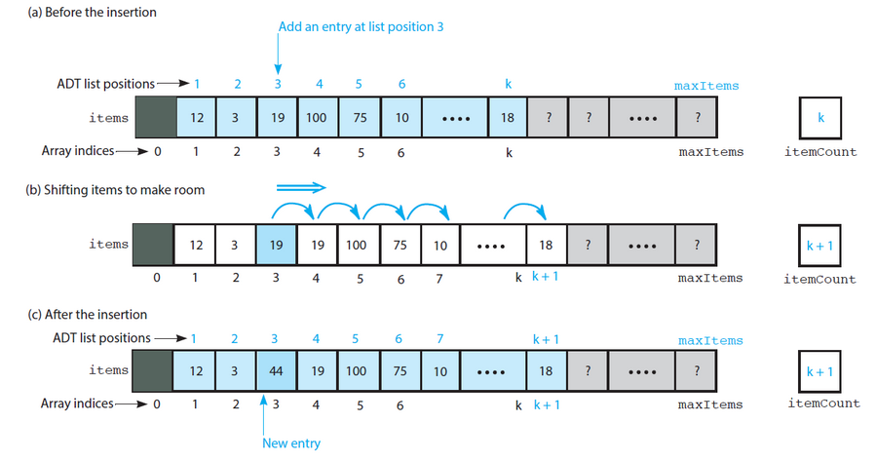
The Implementation File (4 of 24)
Figure 9-2 Shifting items for insertion

Slide 12
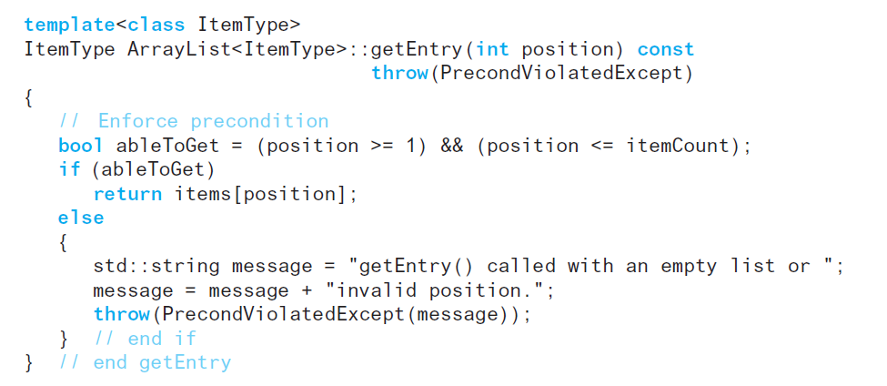
The Implementation File (5 of 24)
Method getEntry

Slide 13
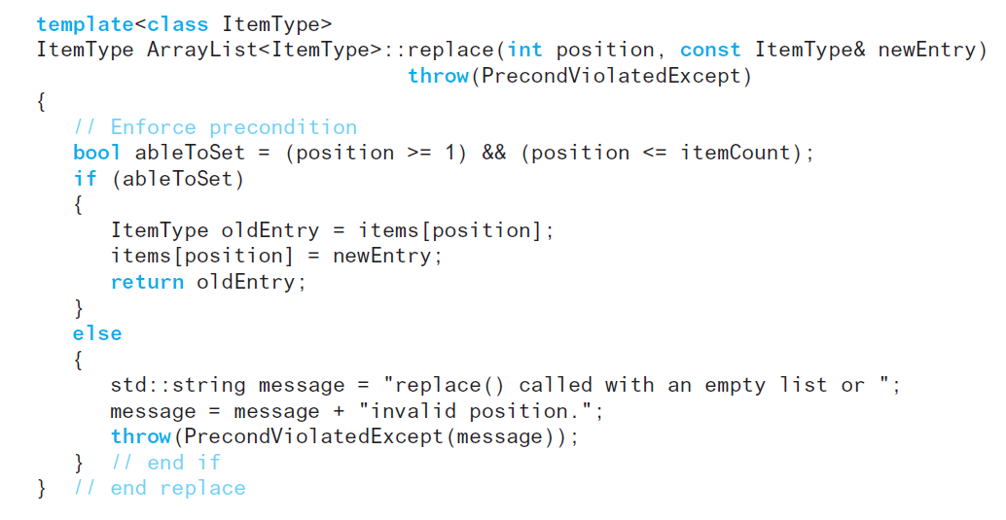
The Implementation File (6 of 24)
Method replace

Slide 14
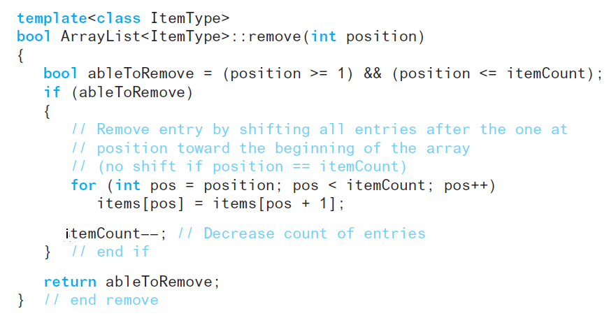
The Implementation File (7 of 24)
Method remove

Slide 15
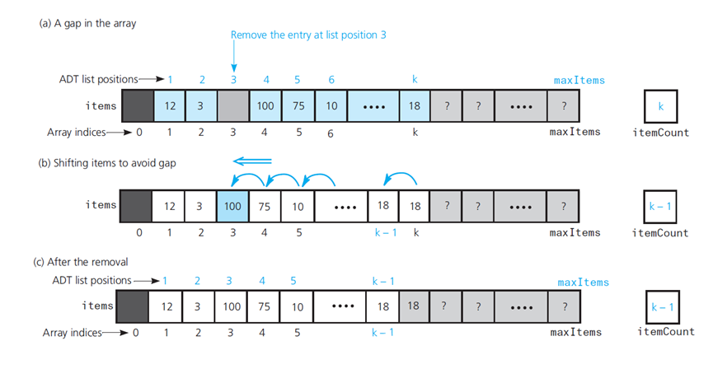
The Implementation File (8 of 24)
Figure 9-3 Shifting items to remove an entry

Slide 16
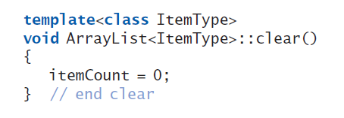
The Implementation File (9 of 24)
Method clear

Slide 17
Link-Based Implementation of the A D T List (1 of 2)
We can use C++ pointers instead of an array to implement A D T list
Link-based implementation does not shift items during insertion and removal operations
We need to represent items in the list and its length

Slide 18
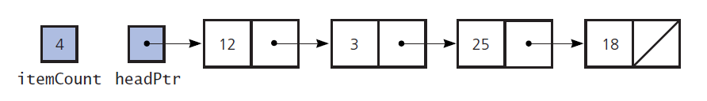
Link-Based Implementation of the A D T List (2 of 2)
Figure 9-4 A link-based implementation of the A D T list

Slide 19
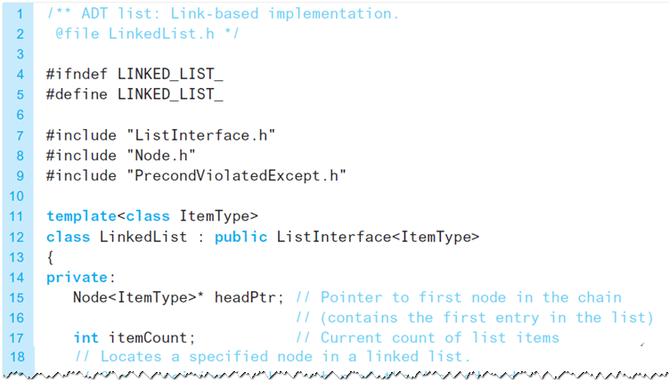
The Header File (5 of 7)
Listing 9-2 The header file for the class LinkedList

Slide 20
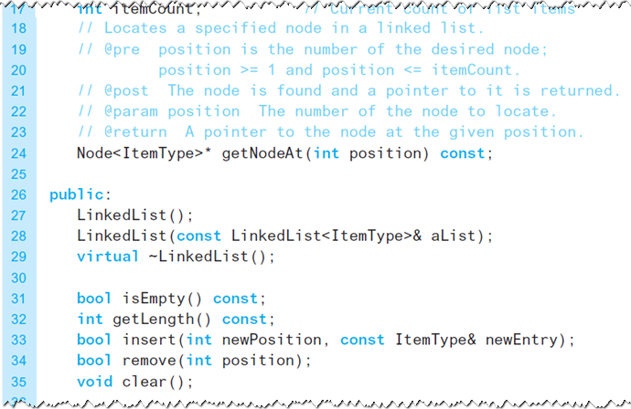
The Header File (6 of 7)
Listing 9-2 [Continued]

Slide 21
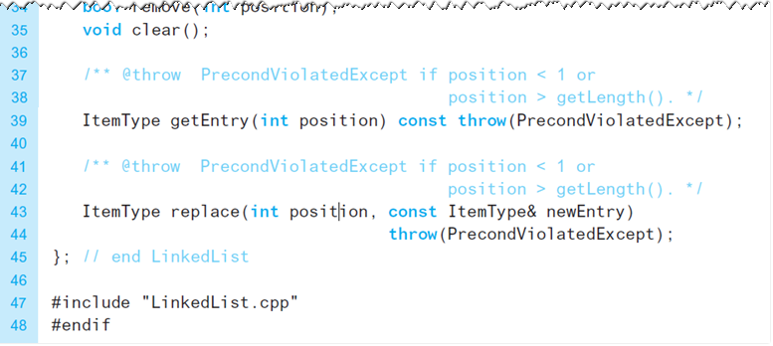
The Header File (7 of 7)
Listing 9-2 [Continued]

Slide 22
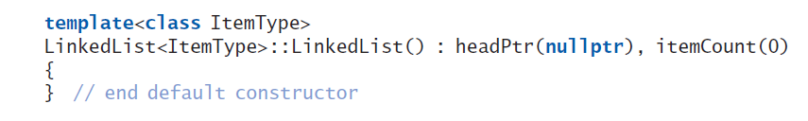
The Implementation File (10 of 24)
Constructor

Slide 23
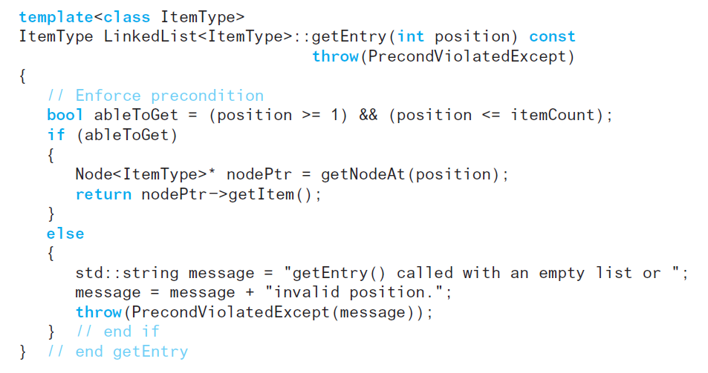
The Implementation File (11 of 24)
Method getEntry

Slide 24
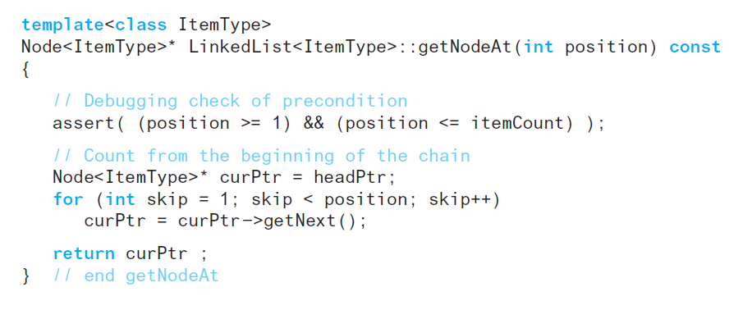
The Implementation File (12 of 24)
Method getNodeAt

Slide 25
The Implementation File (13 of 24)
Insertion process requires three high-level steps:
Create a new node and store the new data in it.
Determine the point of insertion.
Connect the new node to the linked chain by changing pointers.

Slide 26
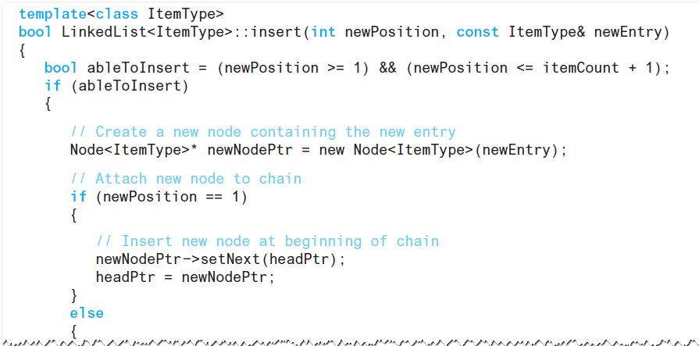
The Implementation File (14 of 24)
Method insert

Slide 27
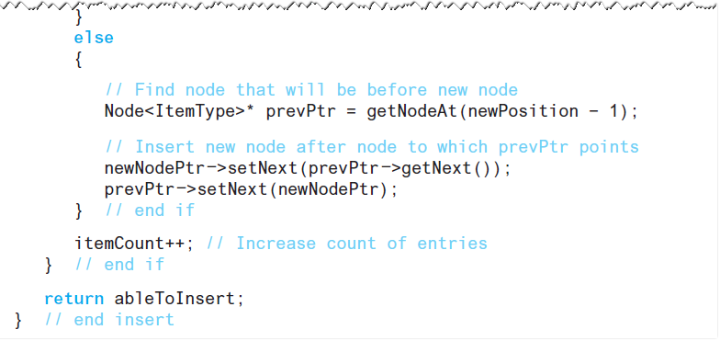
The Implementation File (15 of 24)
Method insert

Slide 28
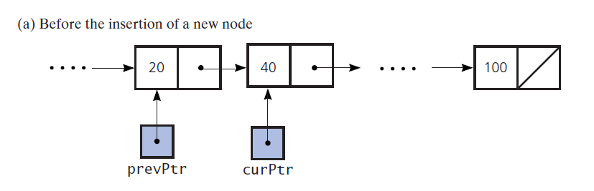
The Implementation File (16 of 24)
Figure 9-5 Inserting a new node between existing nodes of a linked chain

Slide 29
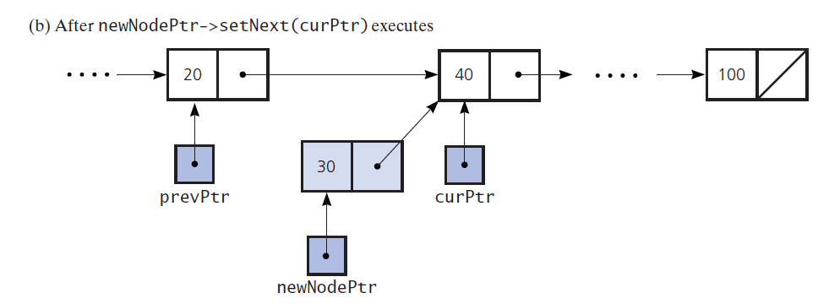
The Implementation File (17 of 24)
Figure 9-5 [Continued]

Slide 30
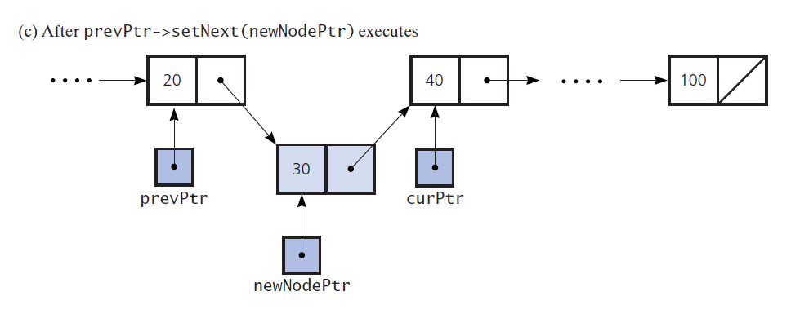
The Implementation File (18 of 24)
Figure 9-5 [Continued]

Slide 31
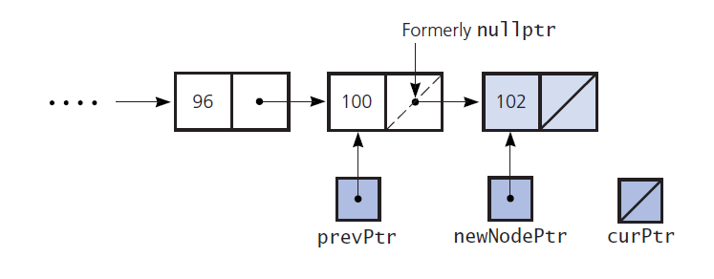
The Implementation File (19 of 24)
Figure 9-6 Inserting a new node at the end of a chain of linked nodes

Slide 32
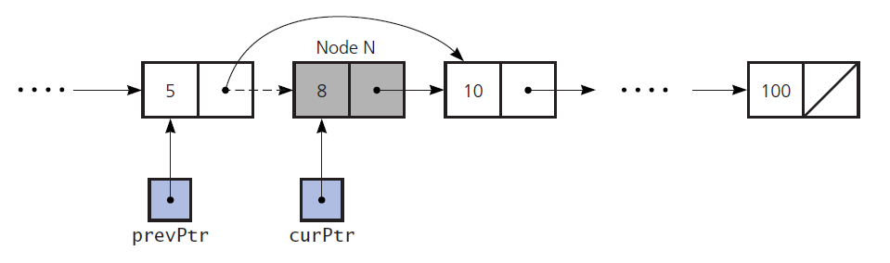
The Implementation File (20 of 24)
Figure 9-7 Removing a node from a chain

Slide 33
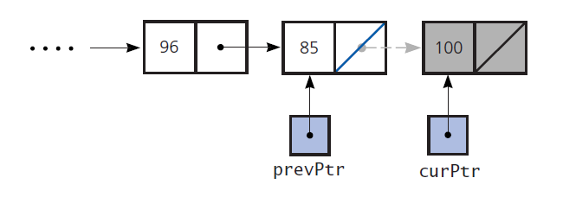
The Implementation File (21 of 24)
Figure 9-8 Removing the last node

Slide 34
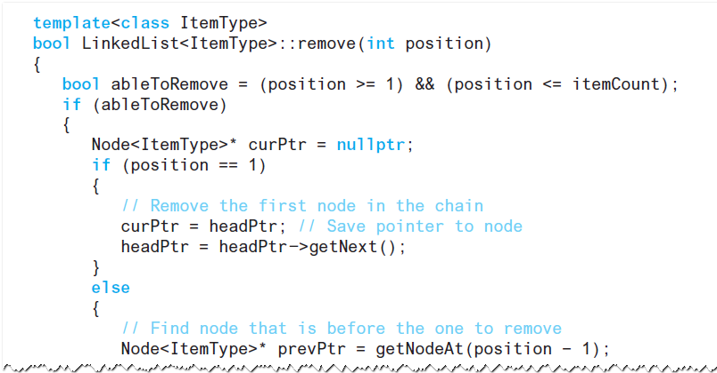
The Implementation File (22 of 24)
Method remove

Slide 35
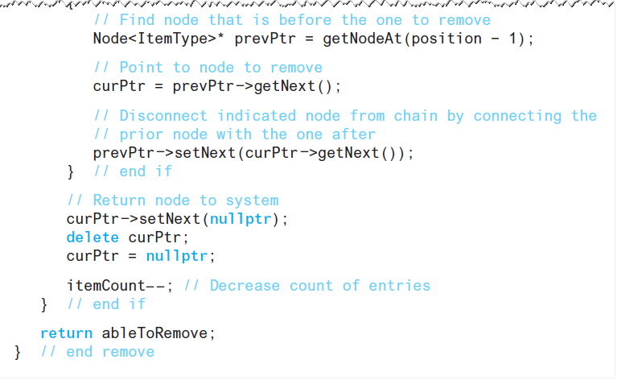
The Implementation File (23 of 24)
Method remove

Slide 36
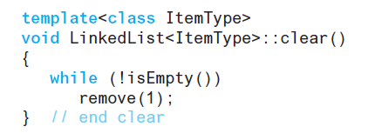
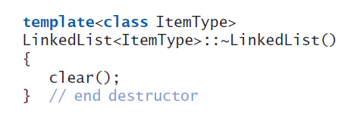
The Implementation File (24 of 24)
Method clear and the destructor

Slide 37
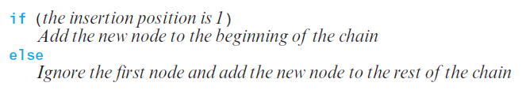
Using Recursion in LinkedList Methods (1 of 5)
Possible to process a linked chain by
Processing its first node and
Then the rest of the chain recursively
Logic used to add a node

Slide 38
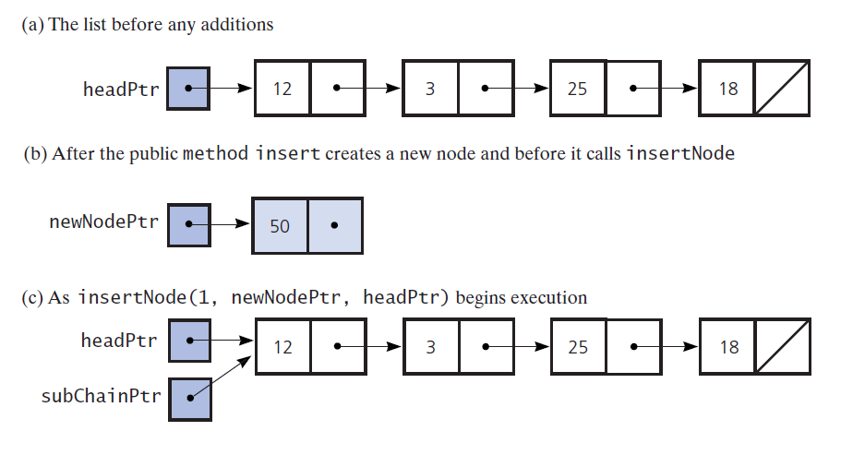
Using Recursion in LinkedList Methods (2 of 5)
Figure 9-9 Recursively adding a node at the beginning of a chain

Slide 39
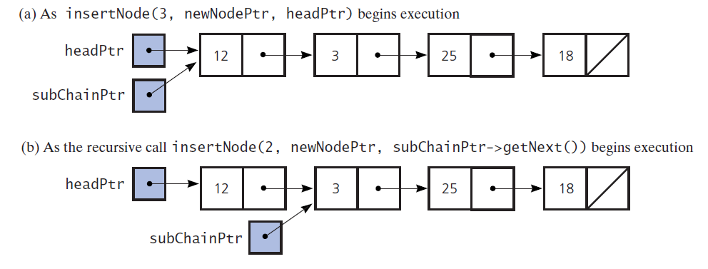
Using Recursion in LinkedList Methods (3 of 5)
Figure 9-10 Recursively adding a node between existing nodes in a chain

Slide 40
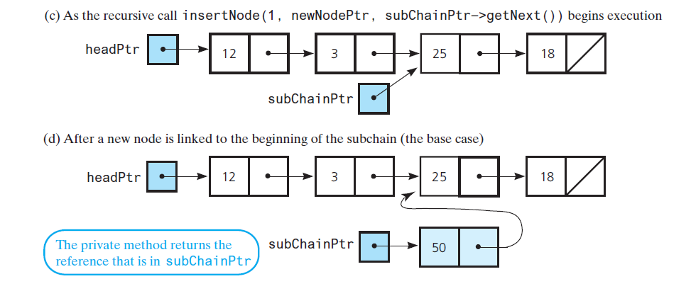
Using Recursion in LinkedList Methods (4 of 5)
Figure 9-10 [Continued]

Slide 41
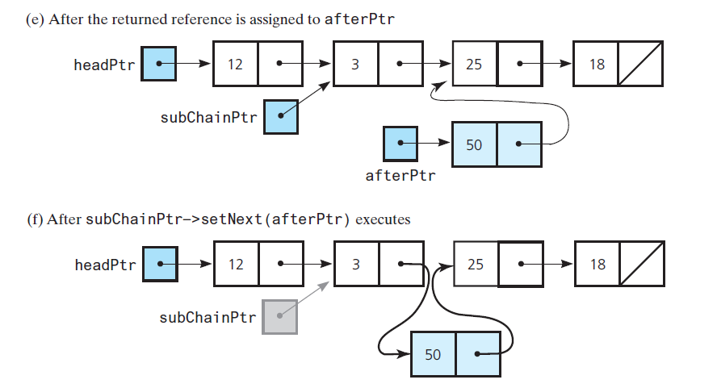
Using Recursion in LinkedList Methods (5 of 5)
Figure 9-10 [Continued]

Slide 42
Comparing Implementations
Time to access the i^{th} node in a chain of linked nodes depends on i
You can access array items directly with equal access time
Insertions and removals with link-based implementation
Do not require shifting data
Do require a traversal

Slide 43

Copyright

